Slide 1
BooYah!
The Time-Based Media Rating App
Group #5
Jigar Joshi (B00812722)
Shivani Desai (B00799169)
Bola Okesanjo (B00876268)
Vivek Shah (B00799155)
Ryan Stevens (B00695460)
Part 1: Sales Pitch
Part 2: Project Defence
Part 3: Demo

Slide 2

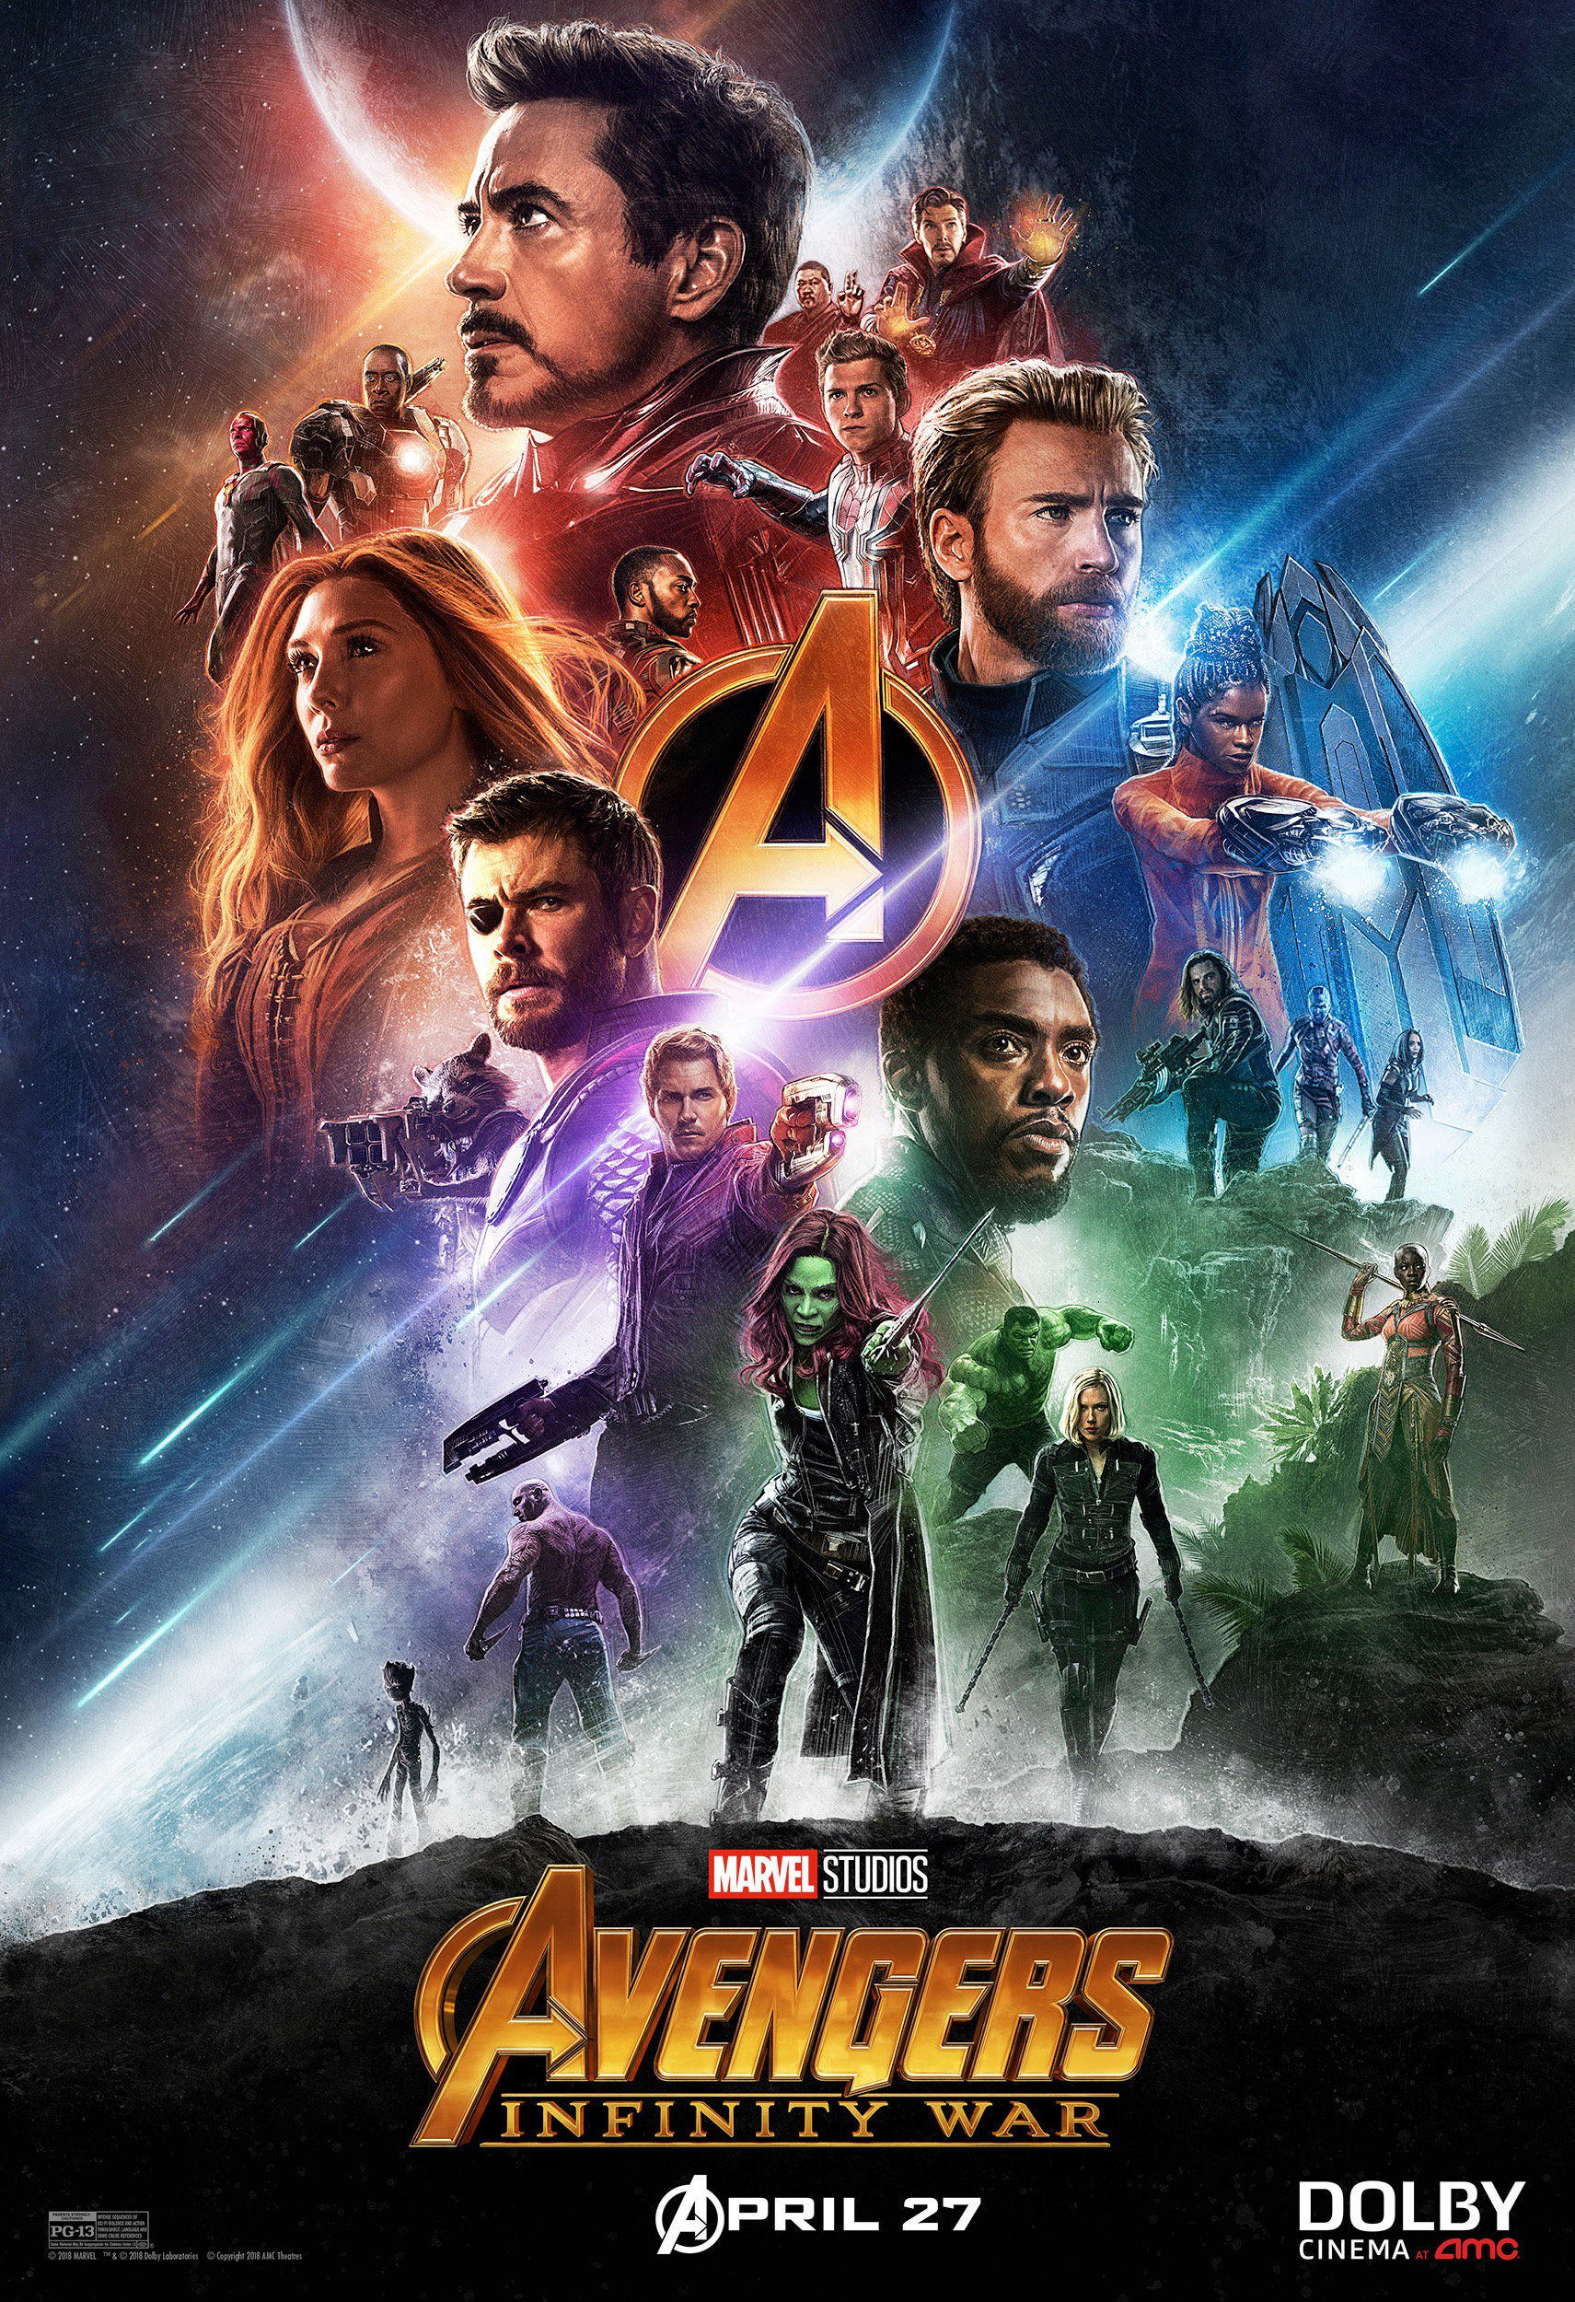


‘C’ontext - Target Audience
TV and Movie Viewers
Teens and Young Adults
The Comfort of Your Own Home
Boo!
Yah!
Notes:
1: Rotten Tomatoes Logo
2: Avengers: Infinity War poster
3: Eragon poster
Who the target audience is, what they use it for, and where/how they use it.

Slide 3
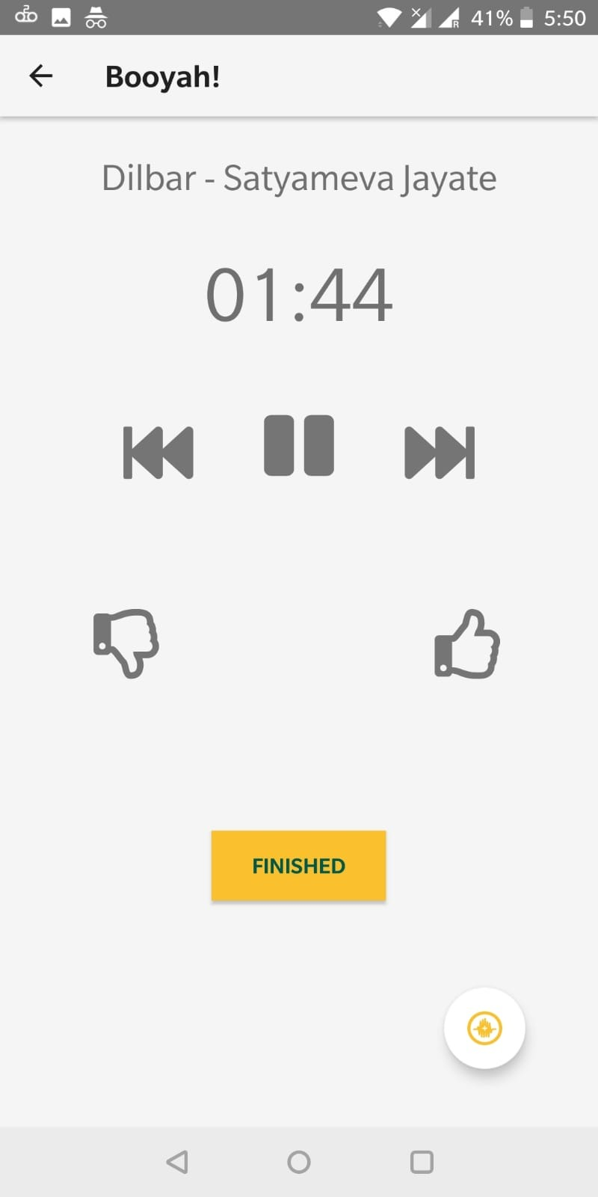
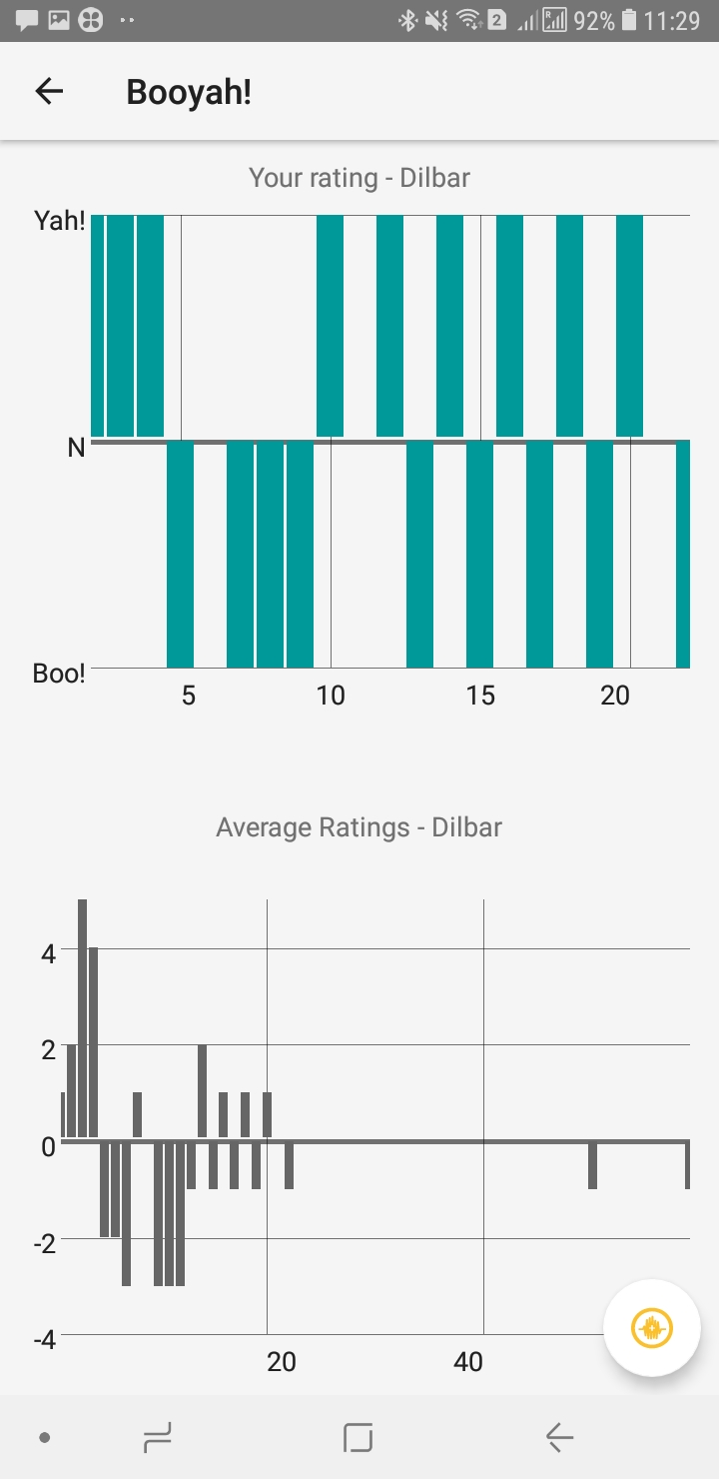
Use to Rate Moments
Rate Movies, TV, Music, and More!
Actionable Feedback for Creators
Adjustable Timer

Slide 4
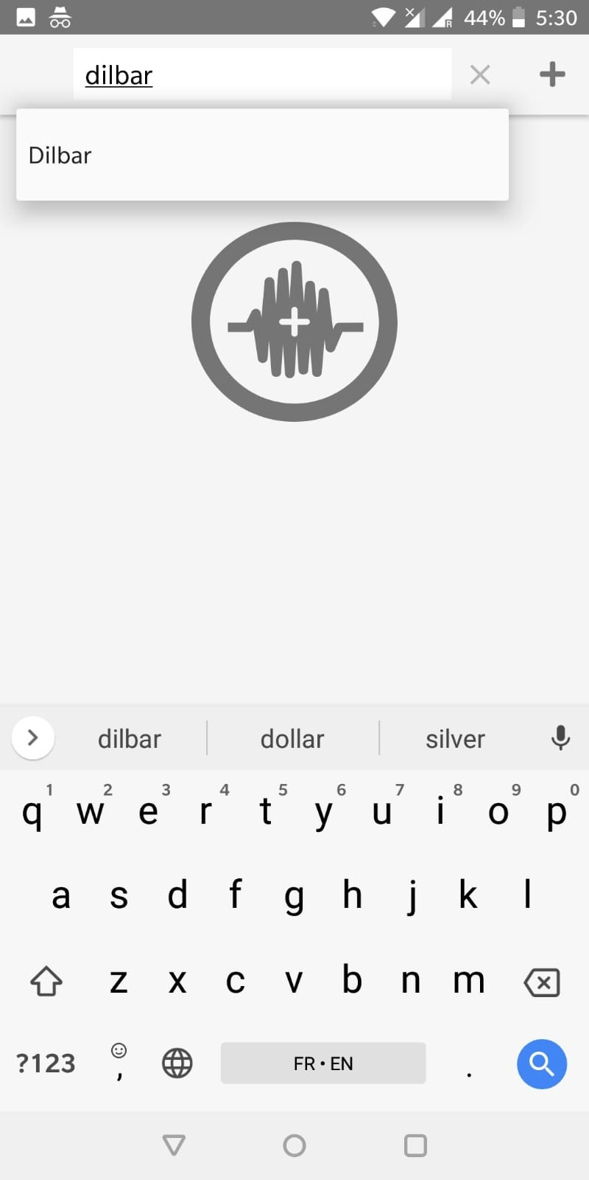
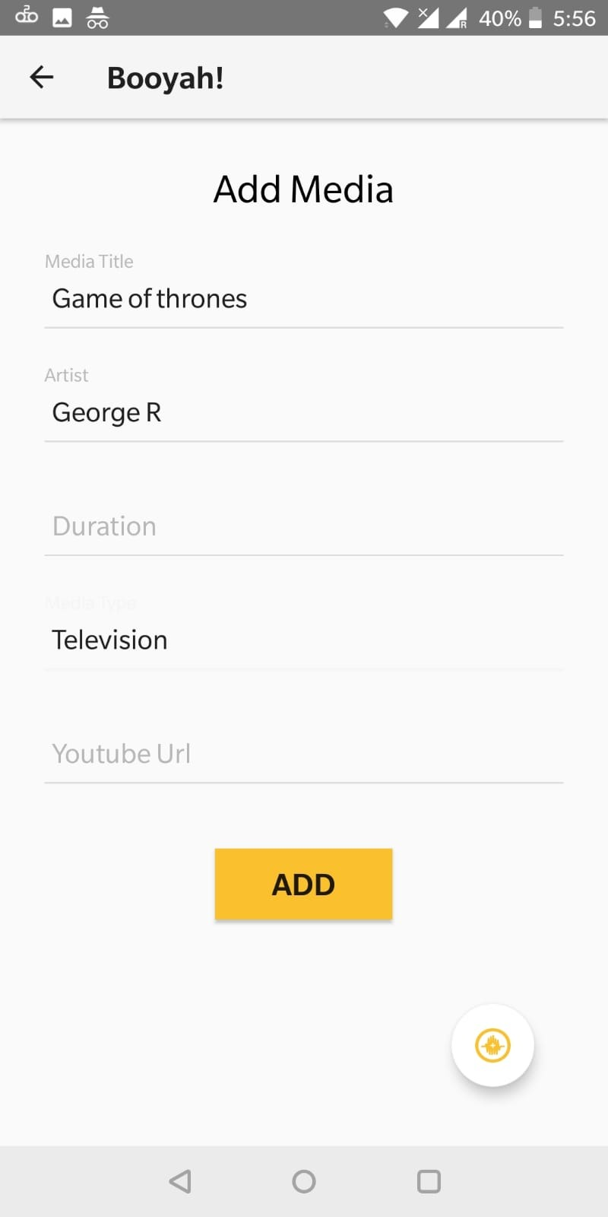
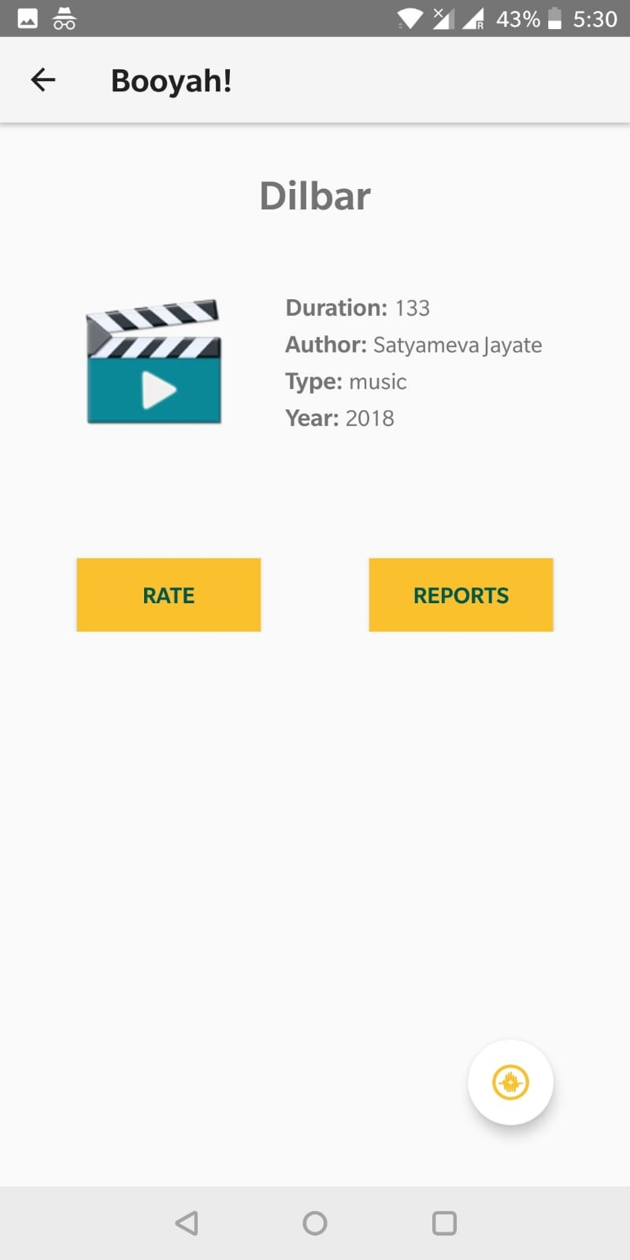
Find or Create
Existing List
OR
Add an Entry

Slide 5
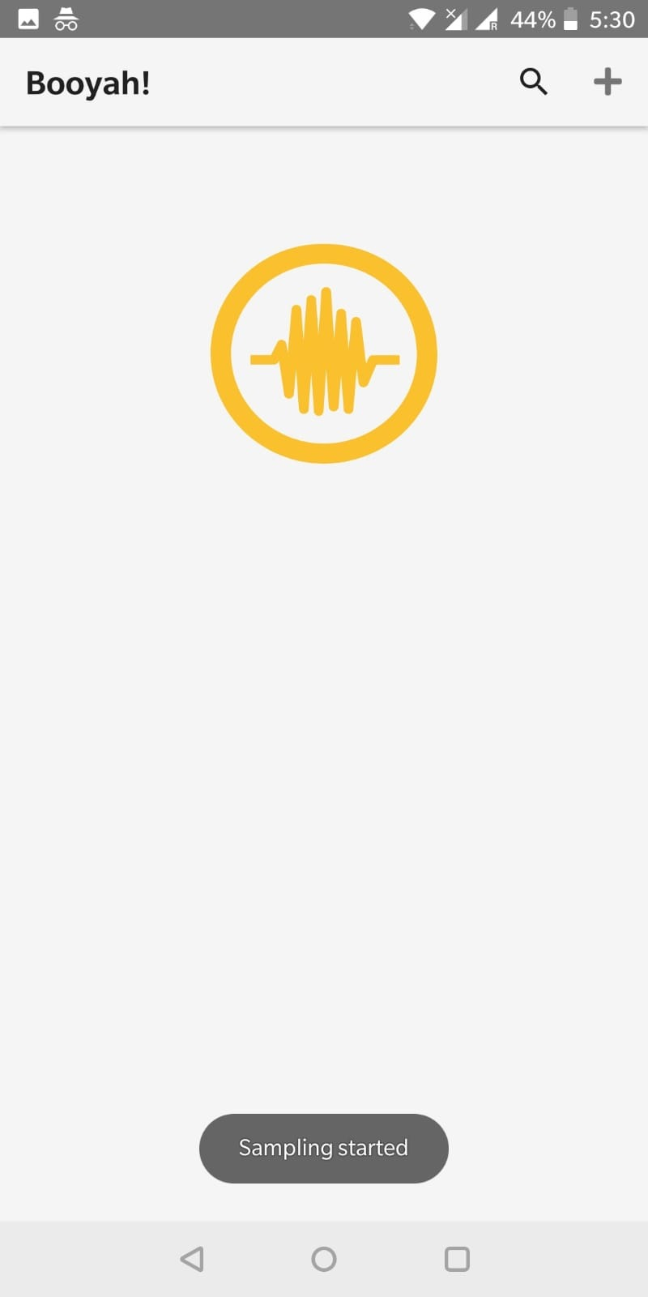

Audio Recognition
Samples 10 seconds of audio
Starts Booyah! session at the detected time
Quick & Easy!
Notes:
4: YouTube logo

Slide 6

Free! No Account Creation!
Auth Key created on first app launch
Device is tied to your account
Free Forever
Notes:
5: Google play Logo

Slide 7
Part 2: Project Defence
Value to the Company
Design Work done
Test cases

Slide 8

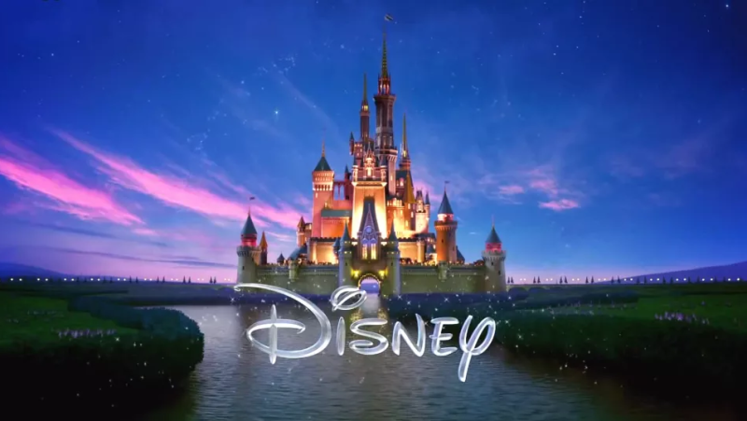
Value
Fun + Free = High Adaptability
Auto-generated auth key:
No Onboarding Overhead
Valuable User data → $
Potential Partnerships
+ Sound Index their Content
Notes:
6: Netflix logo
7: Disney Logo

Slide 9
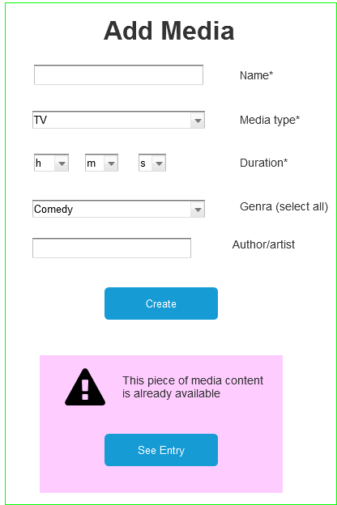
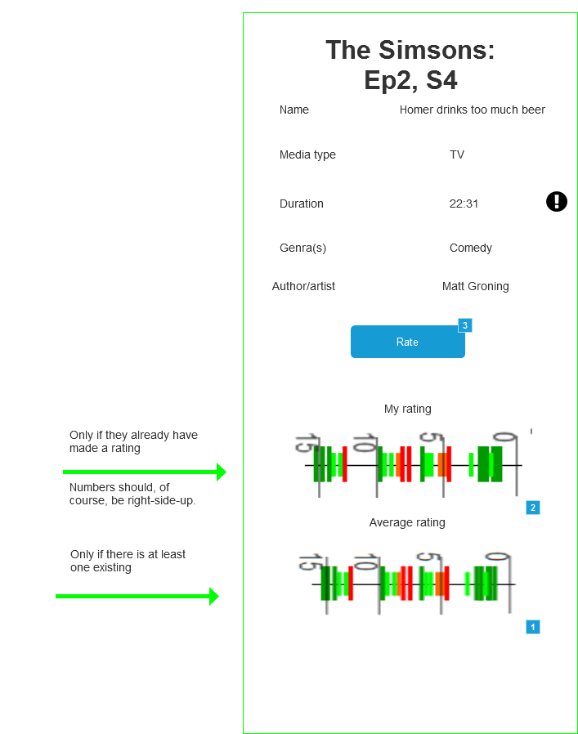
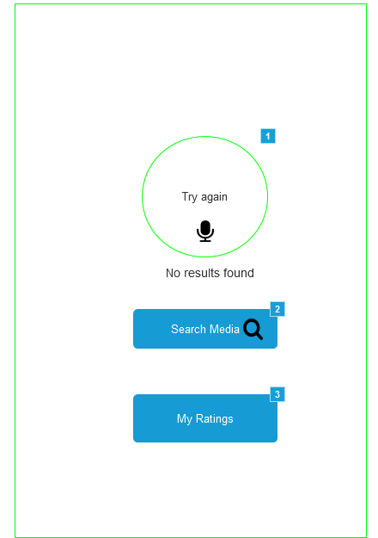
WireFrames

Slide 10
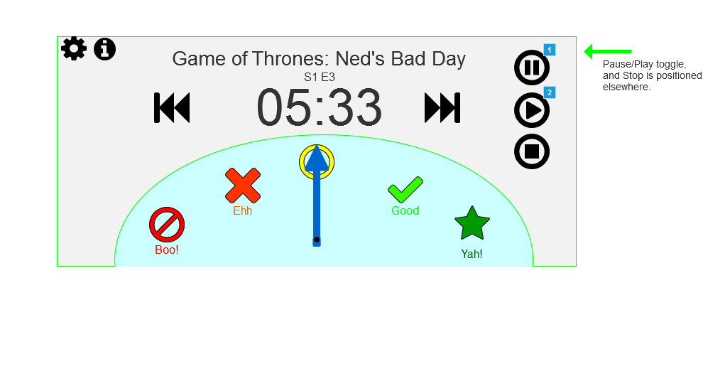
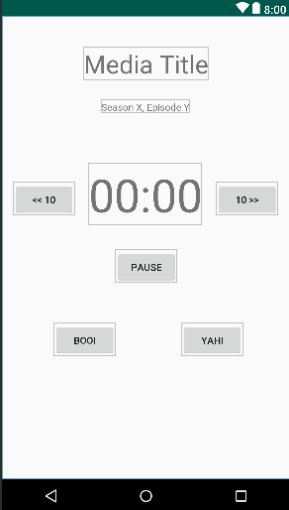
BooYah! Screen
Evolution

Slide 11
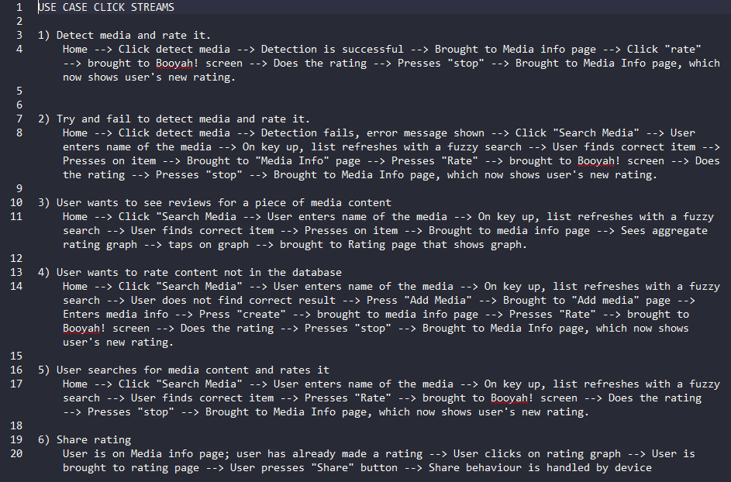
Click Streams: Design & Testing
1) Detect media and rate it.
Home →
Click detect media →
Detection is successful →
Brought to Media info page →
Click "rate" →
Brought to Booyah! screen →
Does the rating →
Presses "stop" →
Brought to Media Info page, which now shows user's new rating.

Slide 12
Part 3: DEMO

Slide 13
Image Sources
1 Rotten Tomatoes Logo: https://www.rottentomatoes.com/assets/pizza-pie/images/icons/global/cf-lg.3c29eff04f2.png
2 Infinity war Poster: https://vignette.wikia.nocookie.net/marveldatabase/images/4/4e/Avengers_Infinity_War_poster_035.jpg/revision/latest?cb=20180413193718
3 Eragon poster: https://www.pastposters.com/cw3/assets/product_full/(JamieR)__Eragon(onesheet)1.jpg
4 YouTube Logo: https://upload.wikimedia.org/wikipedia/commons/thumb/e/e1/Logo_of_YouTube_%282015-2017%29.svg/1280px-Logo_of_YouTube_%282015-2017%29.svg.png
5 Google Play logo : https://www.lywam.org/wp-content/uploads/2015/02/googlePlay-e1423000313115.png
6 Netflix Logo: https://accelerator-origin.kkomando.com/wp-content/uploads/2014/05/new-netflix.jpg
7: Disney Logo: https://i.kinja-img.com/gawker-media/image/upload/s--mATS6PAZ--/c_scale,f_auto,fl_progressive,q_80,w_800/tghjmldn9kihxbe7xacl.png

